Slide 1






Machine learning
Cours 4: Clustering
David Rousseau

Slide 2
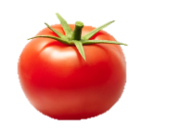
Unsupervised machine learning

Slide 3
Unsupervised machine learning
Clustering
K-Mean
Gaussian Mixture Models
Hierarchical clustering
Mean-shift
Kohonen Self-Organizing Maps
...
Dimensionality reduction
Principle Component Analysis
Neural Networks Auto-encoders
GP-LVM
...
We’ll look at k-Means and GMM for clustering and segmentation

Slide 4
K-Mean clustering
Iterative method to cluster your data
Initialization: pick k random cluster centroids
Based on the centres, assign all points to a cluster
Based on the assignments, recalculate the centroids
Repeat 2-3 until convergence

Slide 5
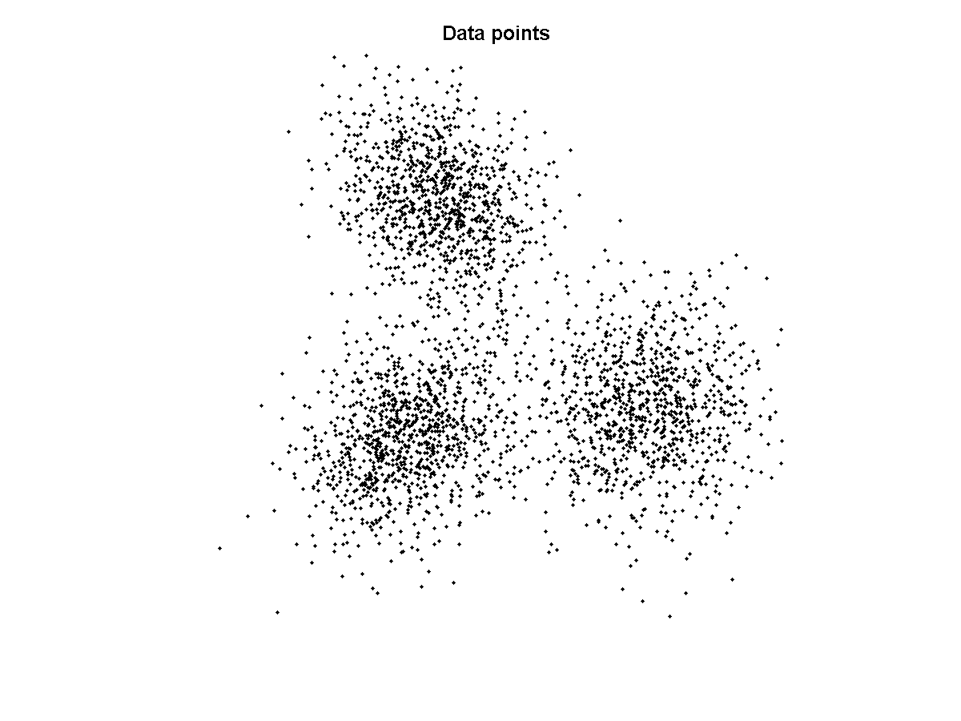
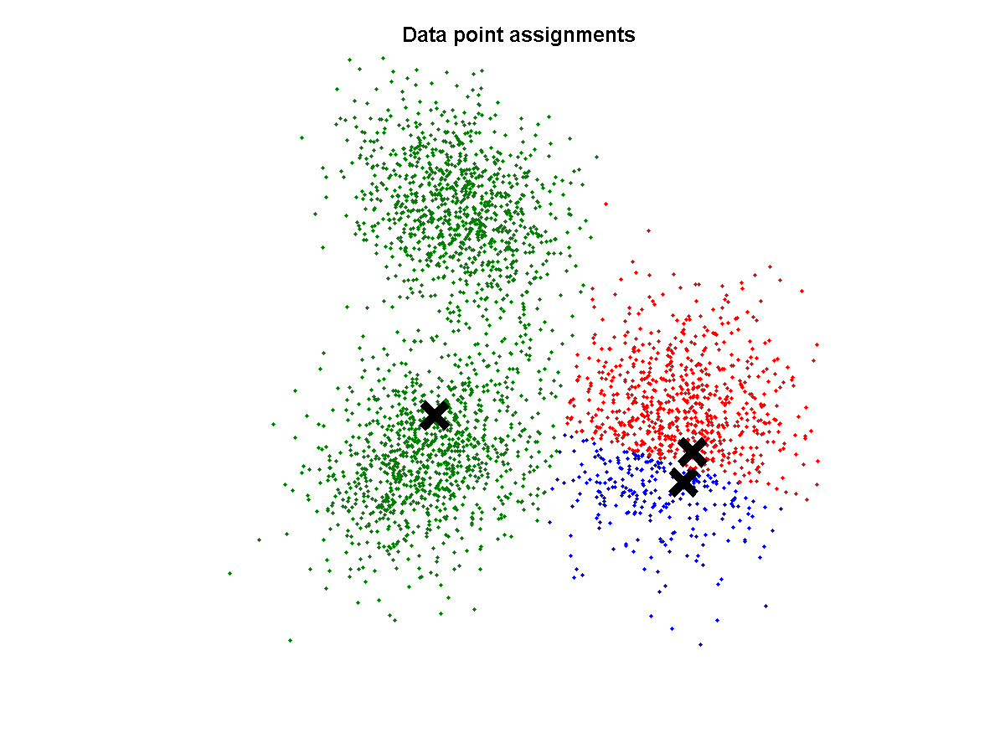
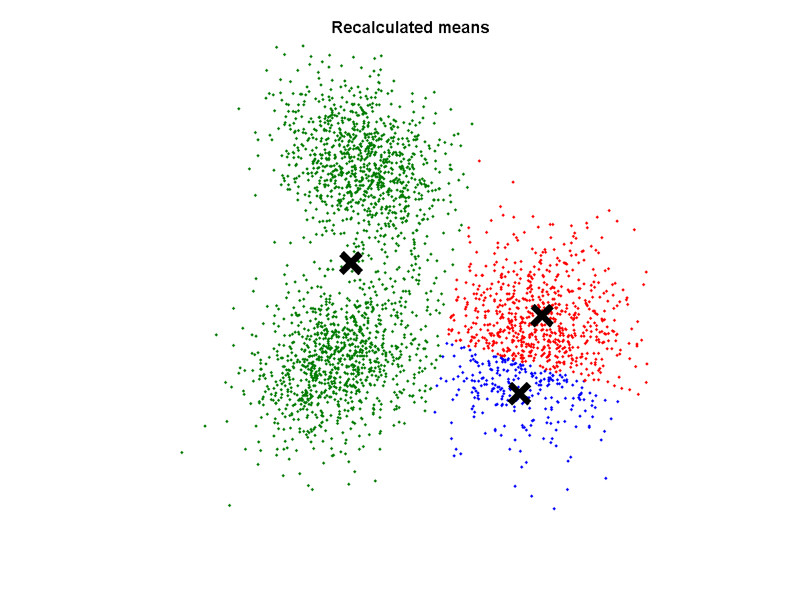
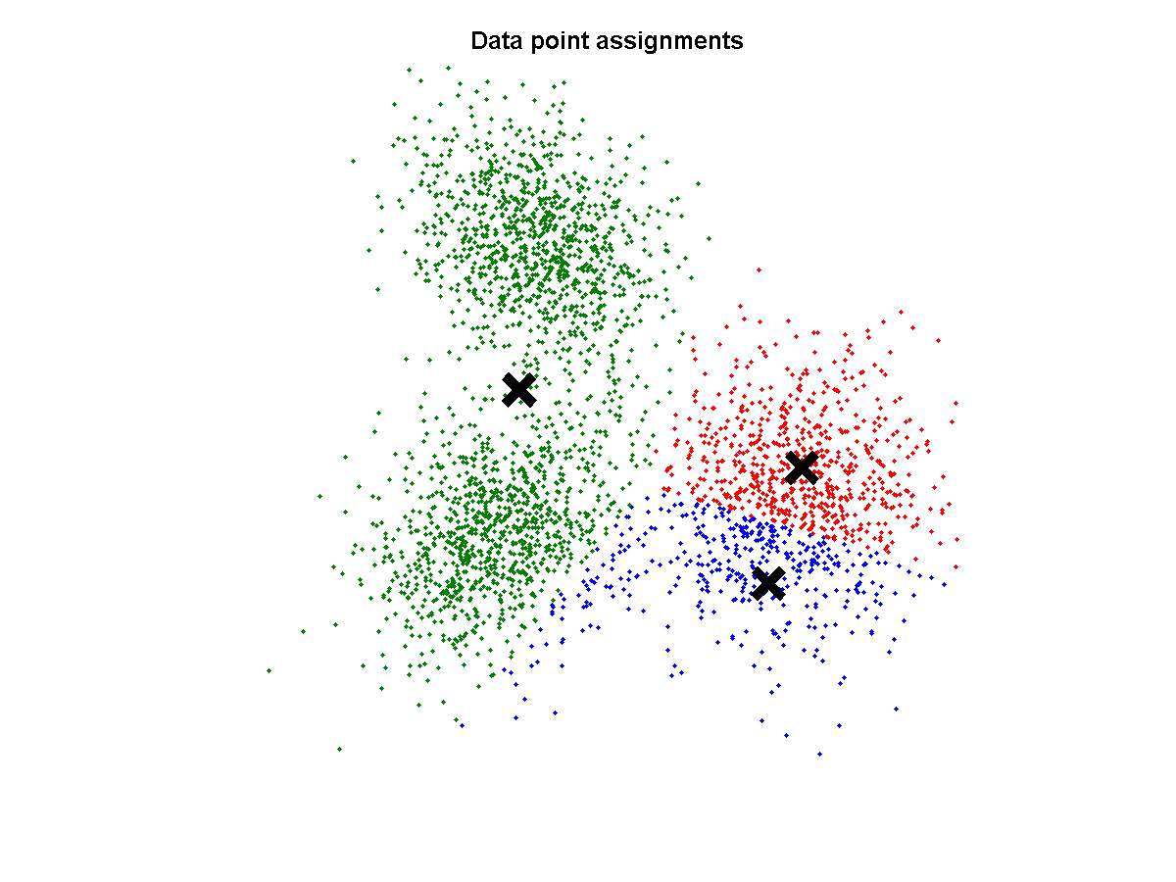

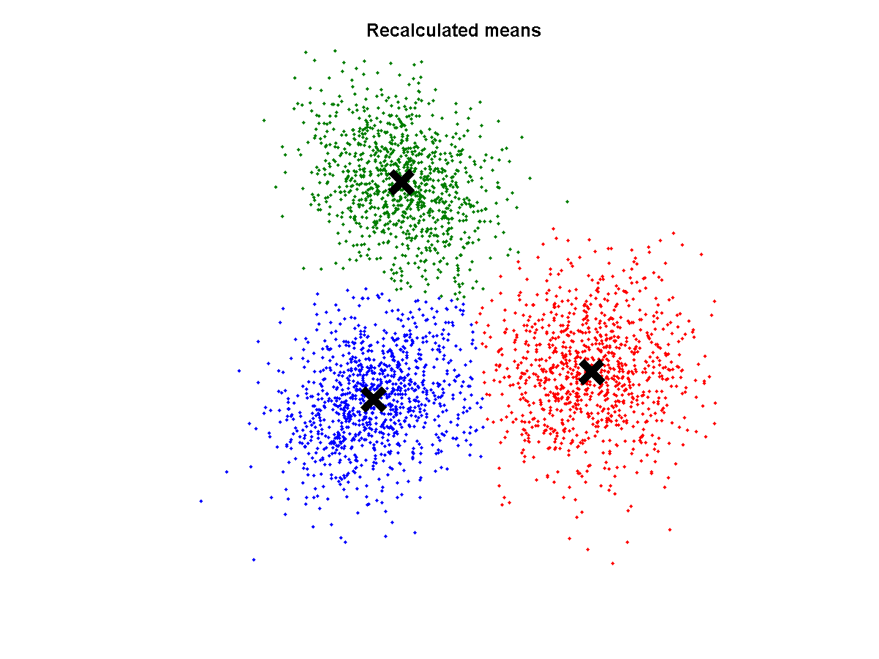


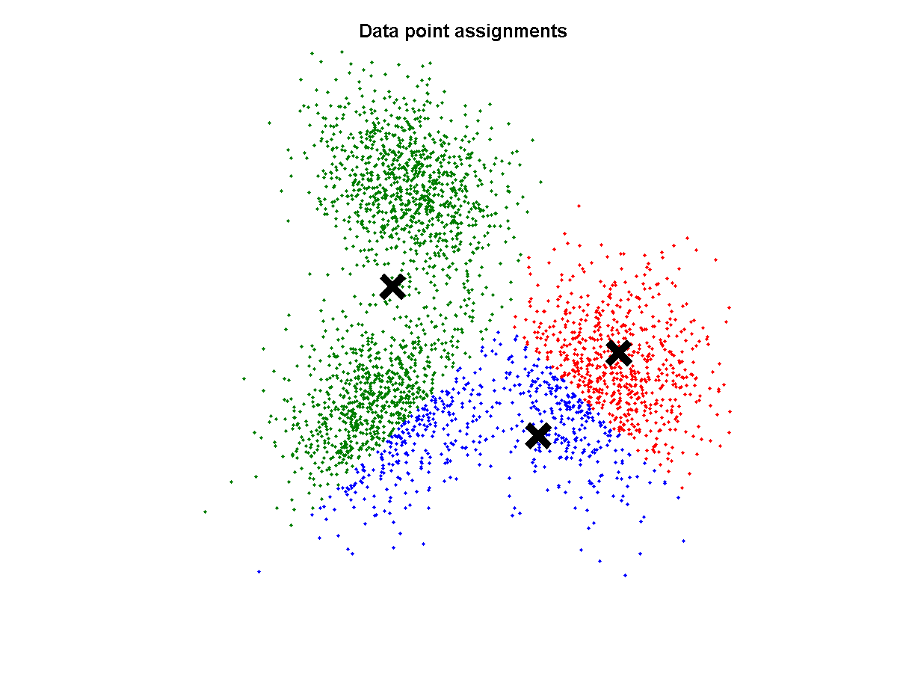
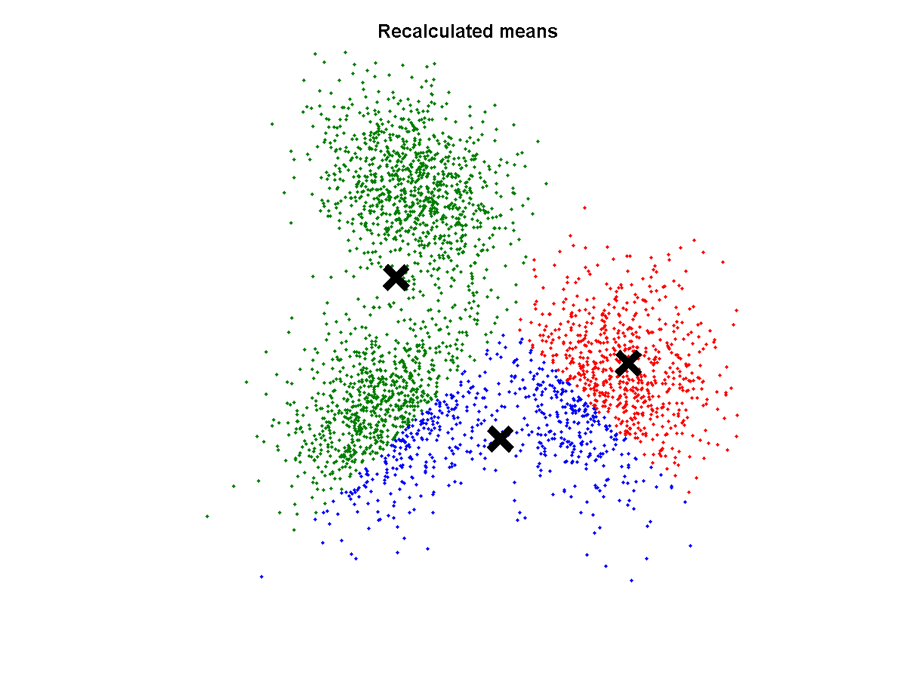
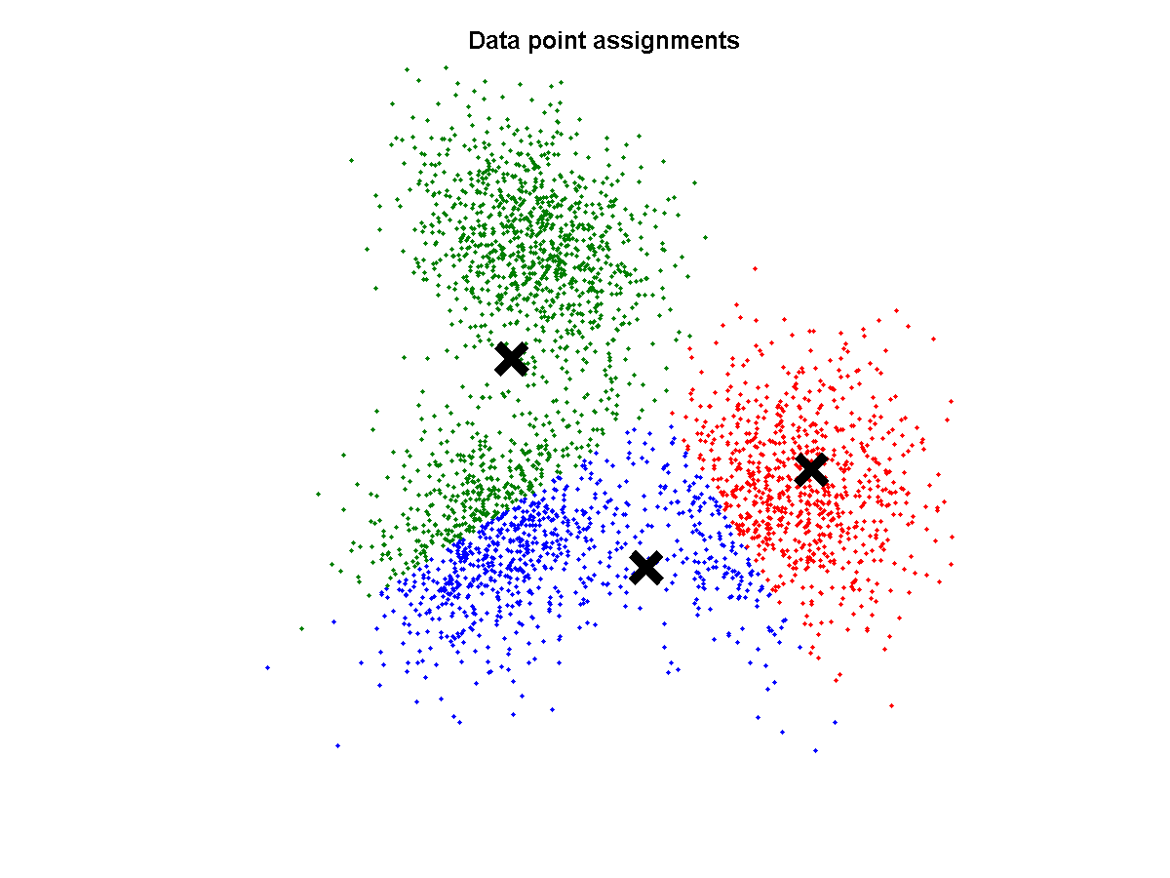
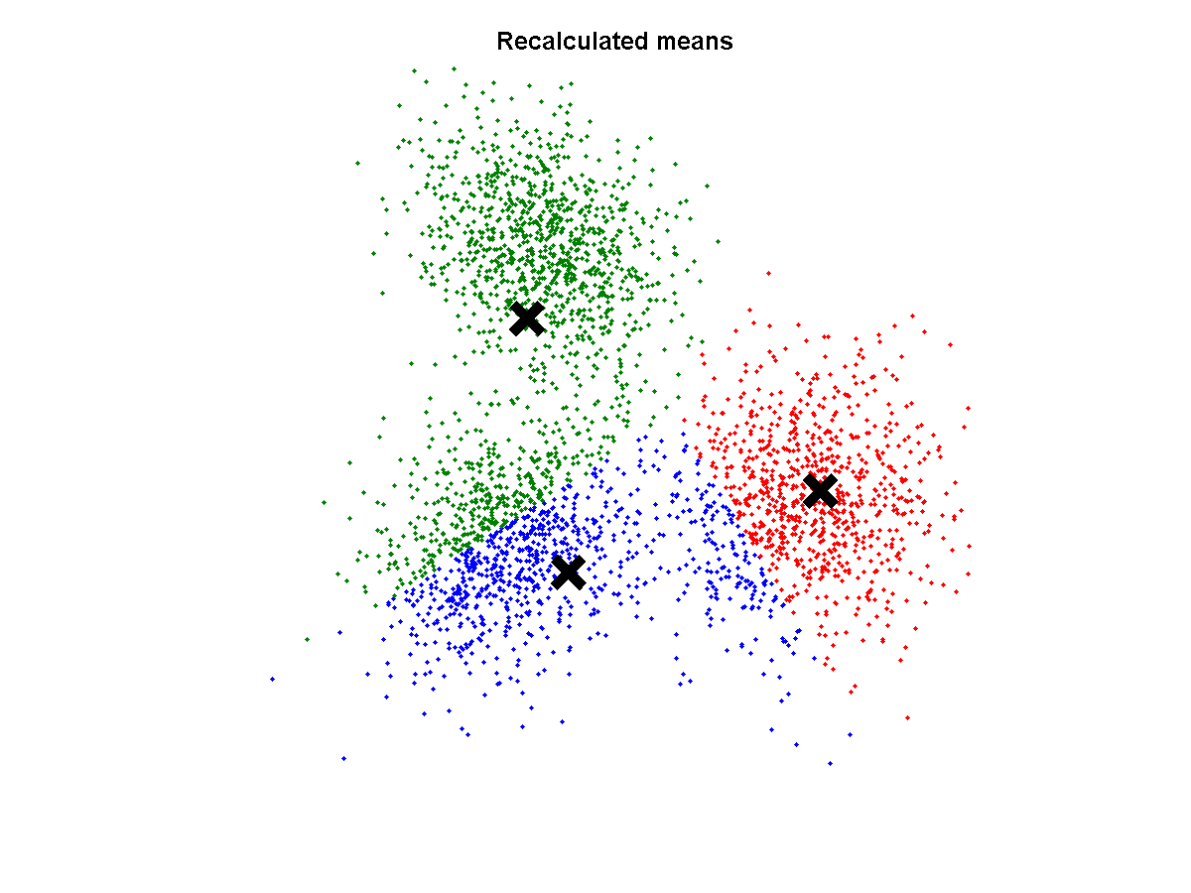
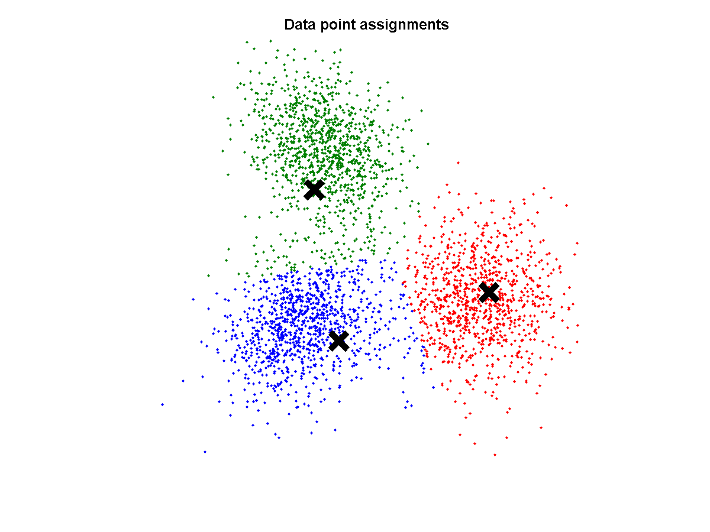









Example of k-Means clustering
Converged

Slide 6
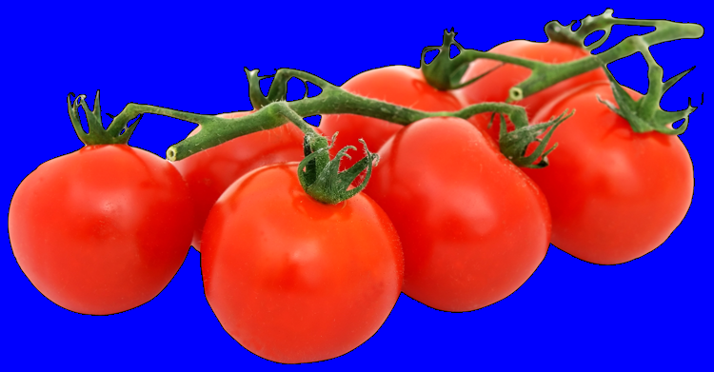
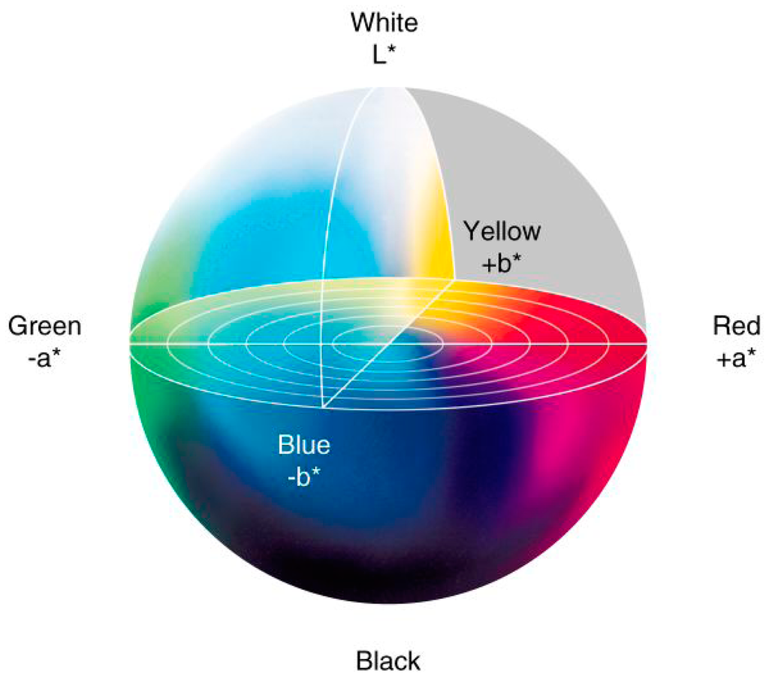
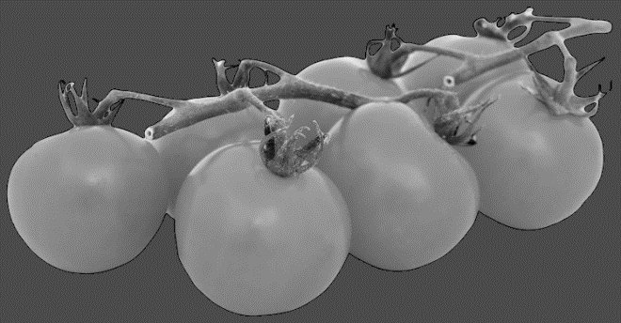
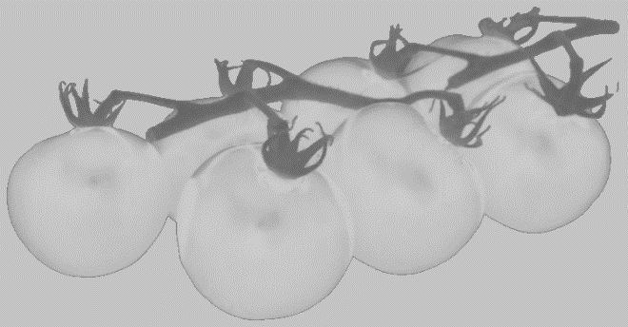
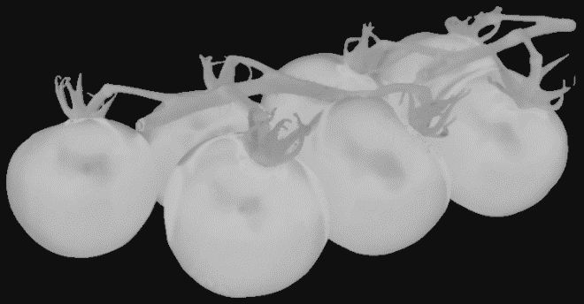
k-Means to segment an image (1)
Transforming to CIE L*a*b* colorspace
To better deal with shadows
Luminance
a*
b*

Slide 7
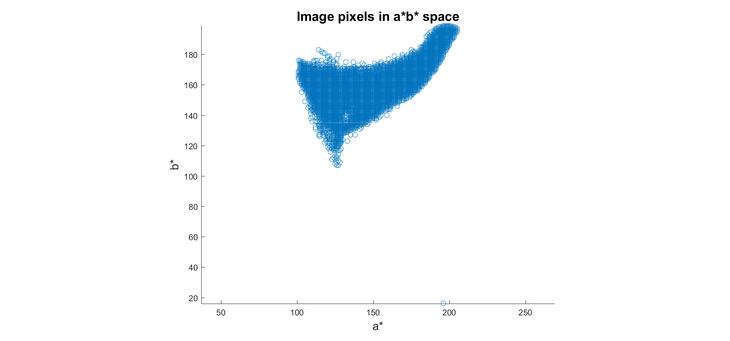
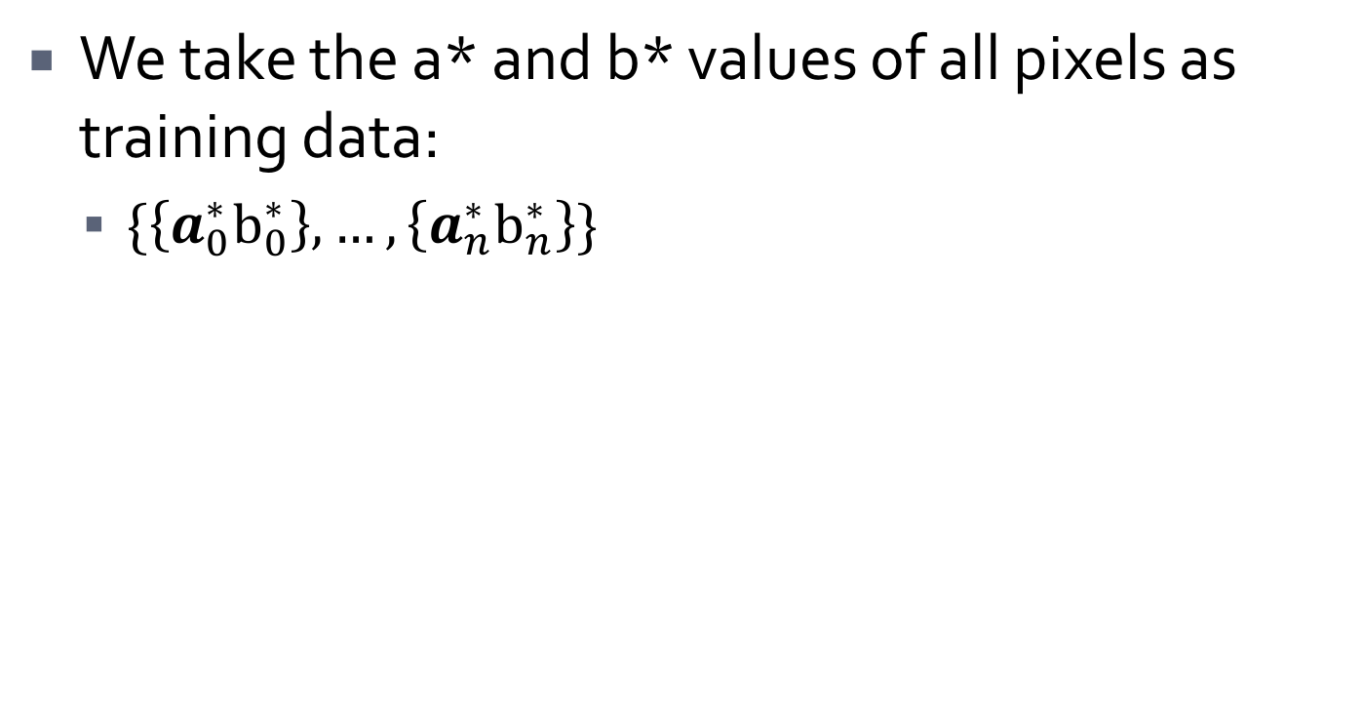
k-Means to segment an image (2)
We take the a* and b* values of all pixels as training data:
$\{\left\{a_{0}^{∗}b_{0}^{∗}\right\}, …,\left\{a_{n}^{∗}b_{n}^{∗}\right\}\}$

Slide 8
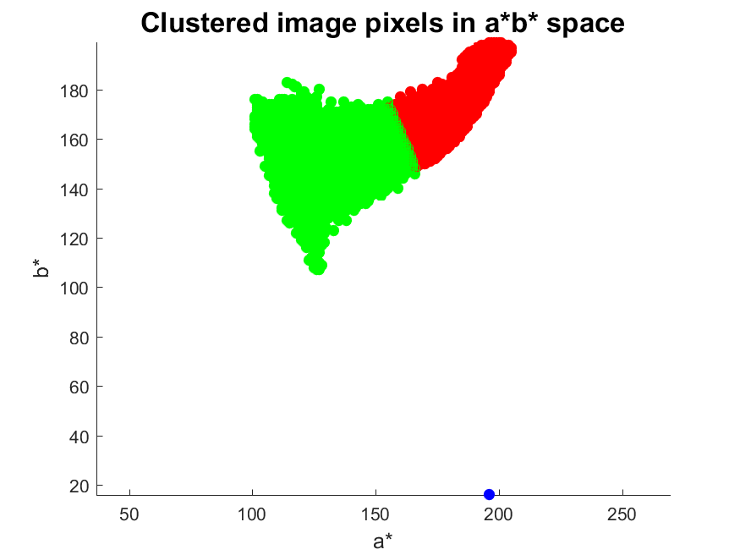
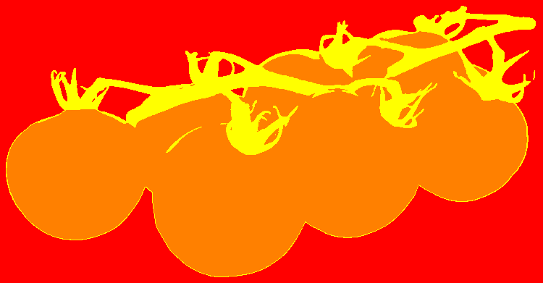
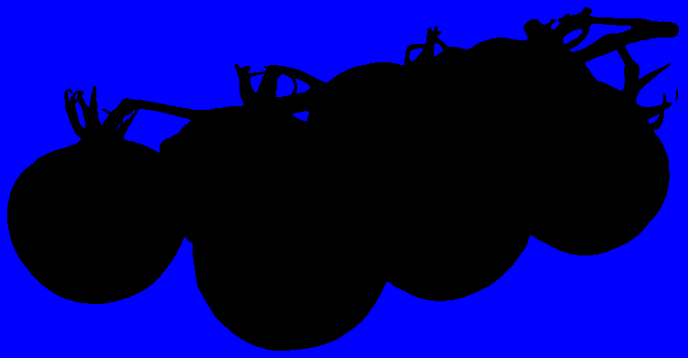
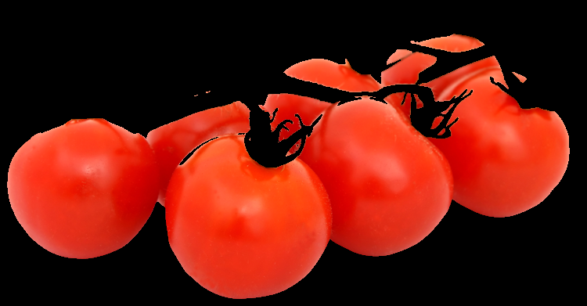
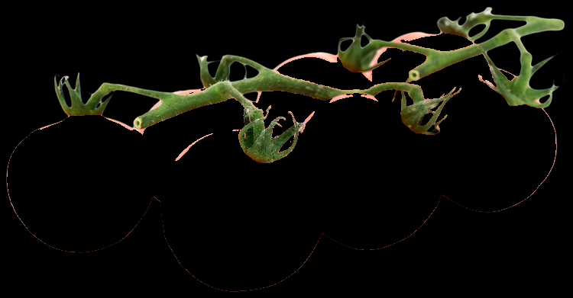
k-Means to segment an image (3)
Clusters in a*b* space
Resulting segmented image

Slide 9
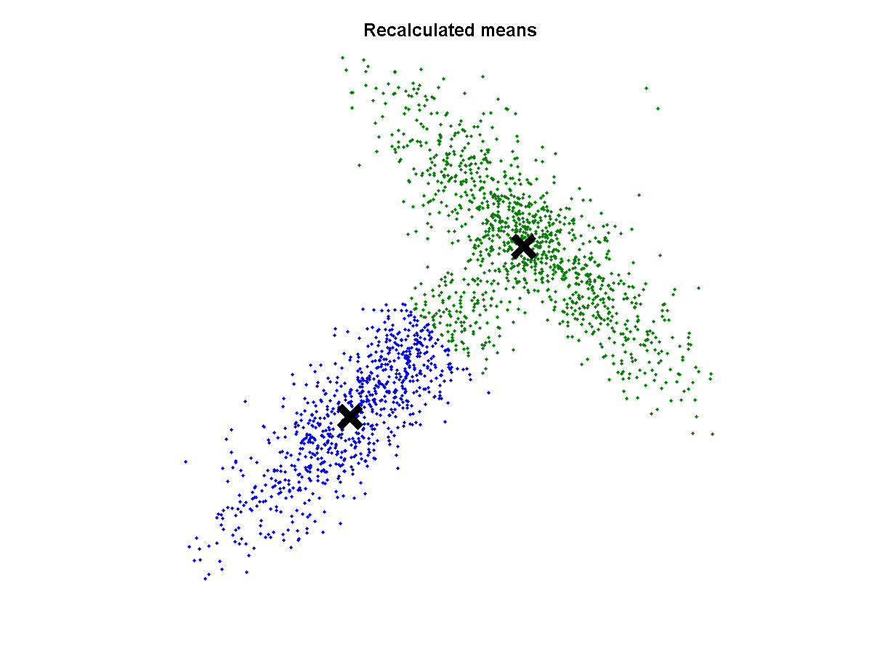
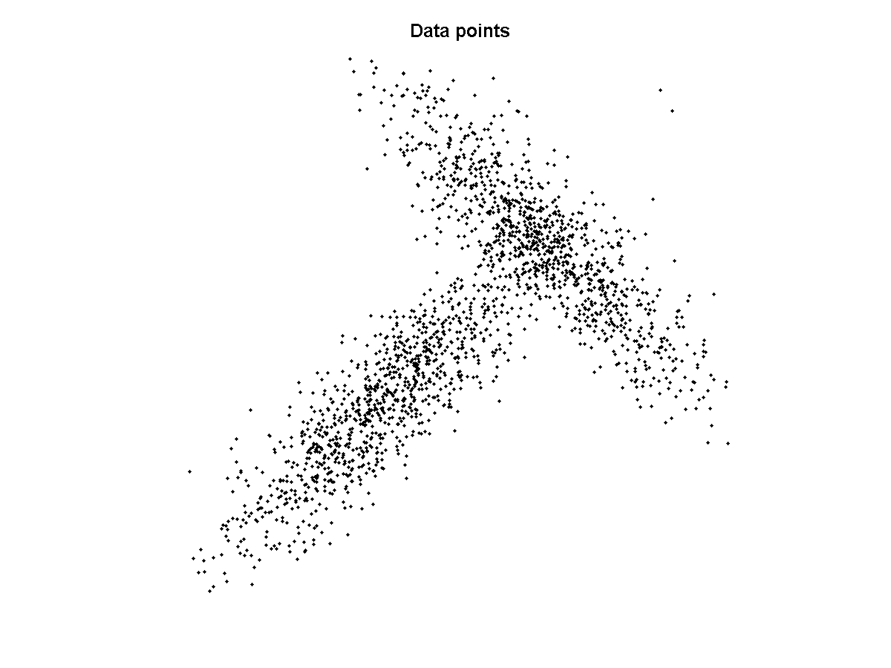
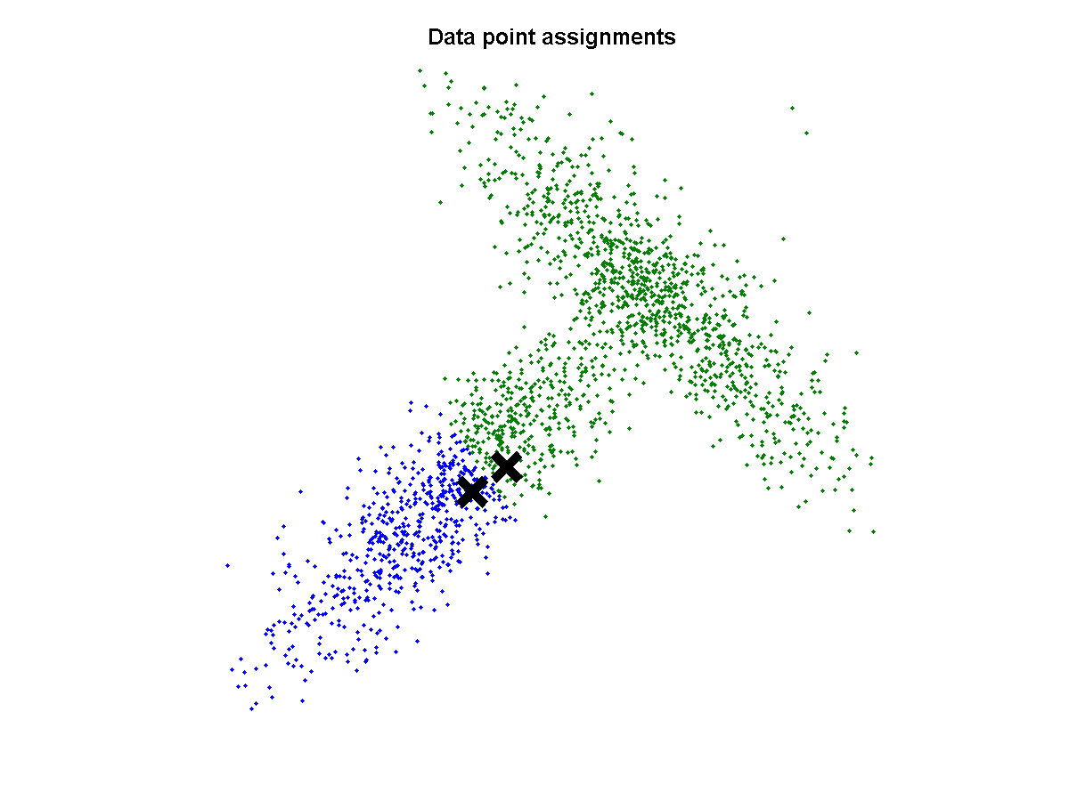
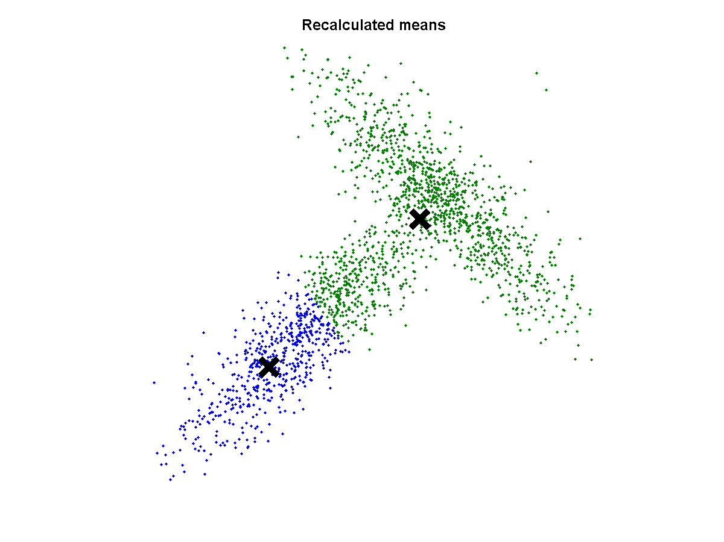
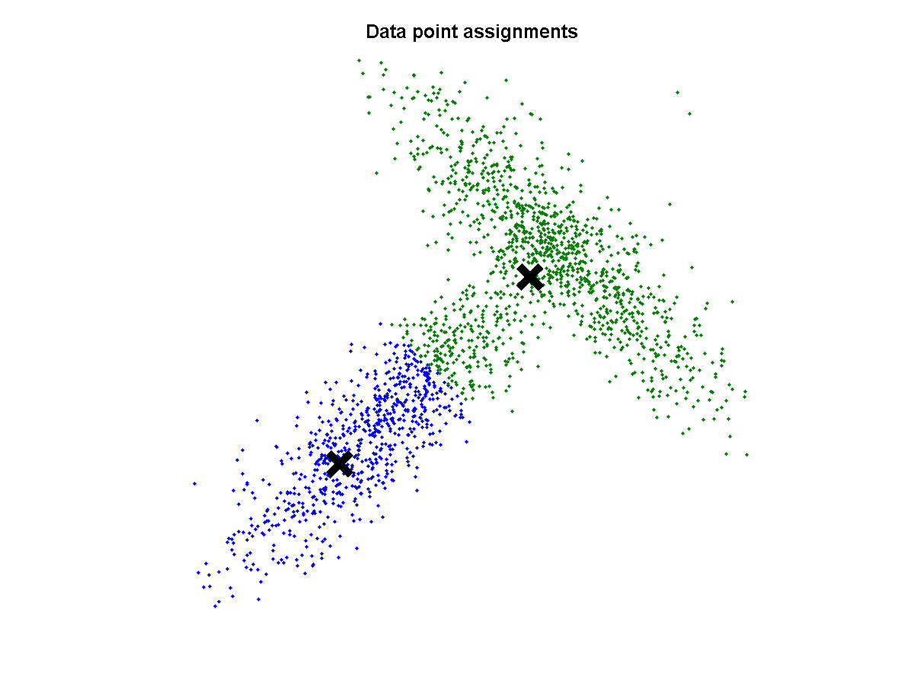



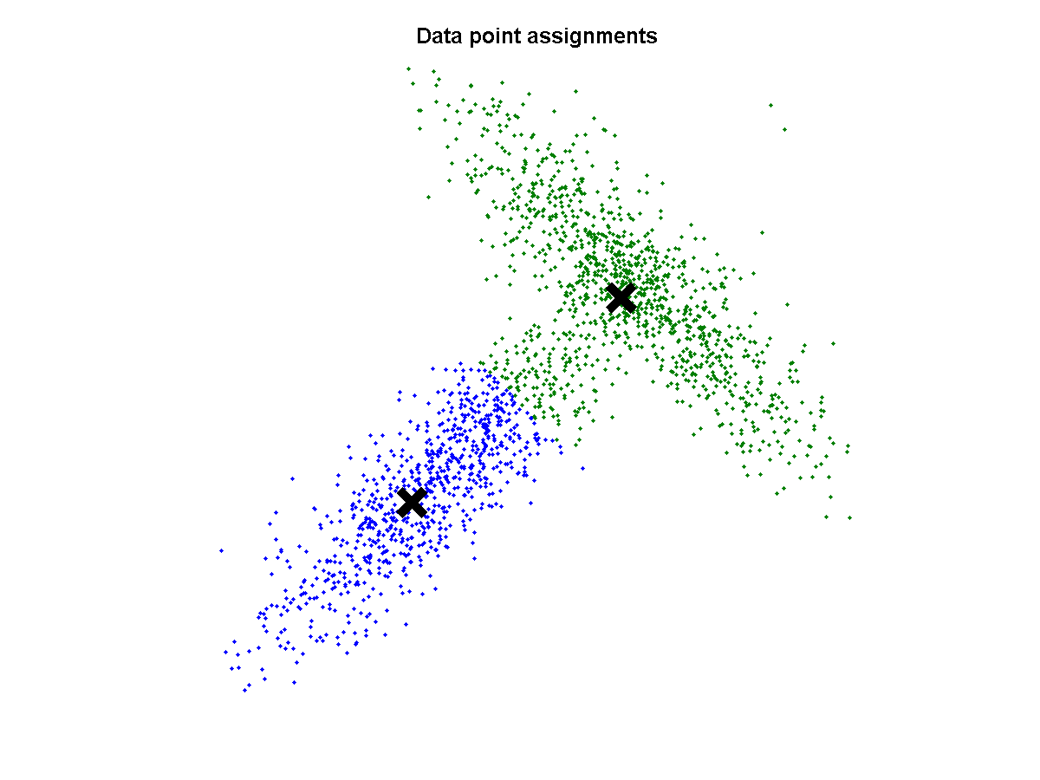





Where k-Means goes wrong
k-Means clustering assumes (hyper)spherical distributions
Only based on distance from cluster centres
Does not take the distribution of points into account
..., but to the wrong solution
Converged...

Slide 10
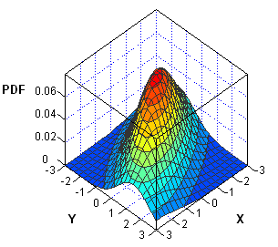
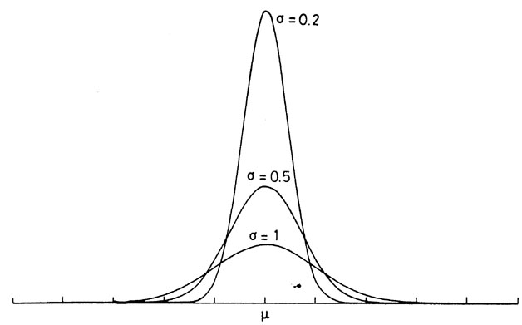
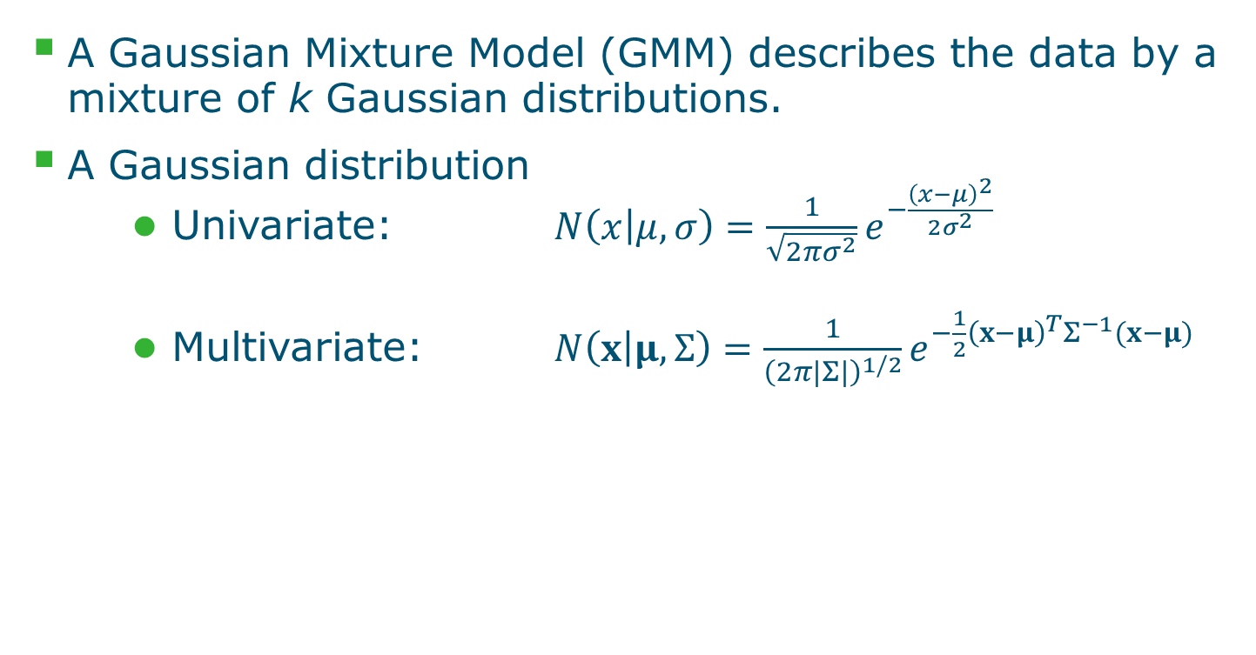
Gaussian Mixture Models
A Gaussian Mixture Model (GMM) describes the data by a mixture of k Gaussian distributions.
A Gaussian distribution
Univariate: $N\left(x | μ, σ\right)=\frac{1}{\sqrt{2πσ^{2}}}e^{−\frac{{\left(x−μ\right)}^{2}}{2σ^{2}}}$
Multivariate: $N\left(x | μ,Σ\right)=\frac{1}{{\left(2π|Σ|\right)}^{1/2}}e^{−\frac{1}{2}{\left(x−μ\right)}^{T}Σ^{−1}(x−μ)}$

Slide 11
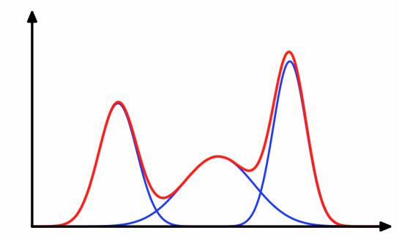
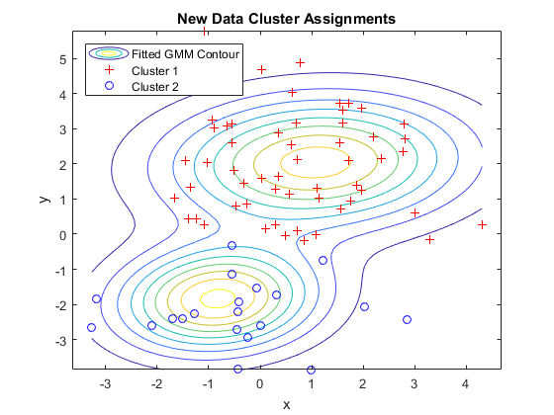
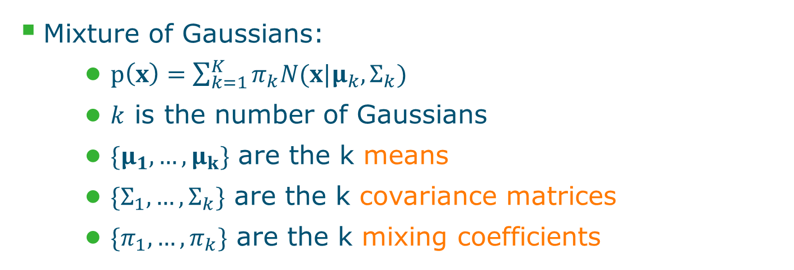
Gaussian Mixture Models
Mixture of Gaussians:
$p\left(x\right)=\sum_{k=1}^{K}{π_{k}N(x|μ_{k},Σ_{k})}$
$k$ is the number of Gaussians
$\{μ_{1},…,μ_{k}\}$ are the k means
$\{Σ_{1},…,Σ_{k}\}$ are the k covariance matrices
$\{π_{1},…, π_{k}\}$ are the k mixing coefficients
These need to be fitted on the data

Slide 12
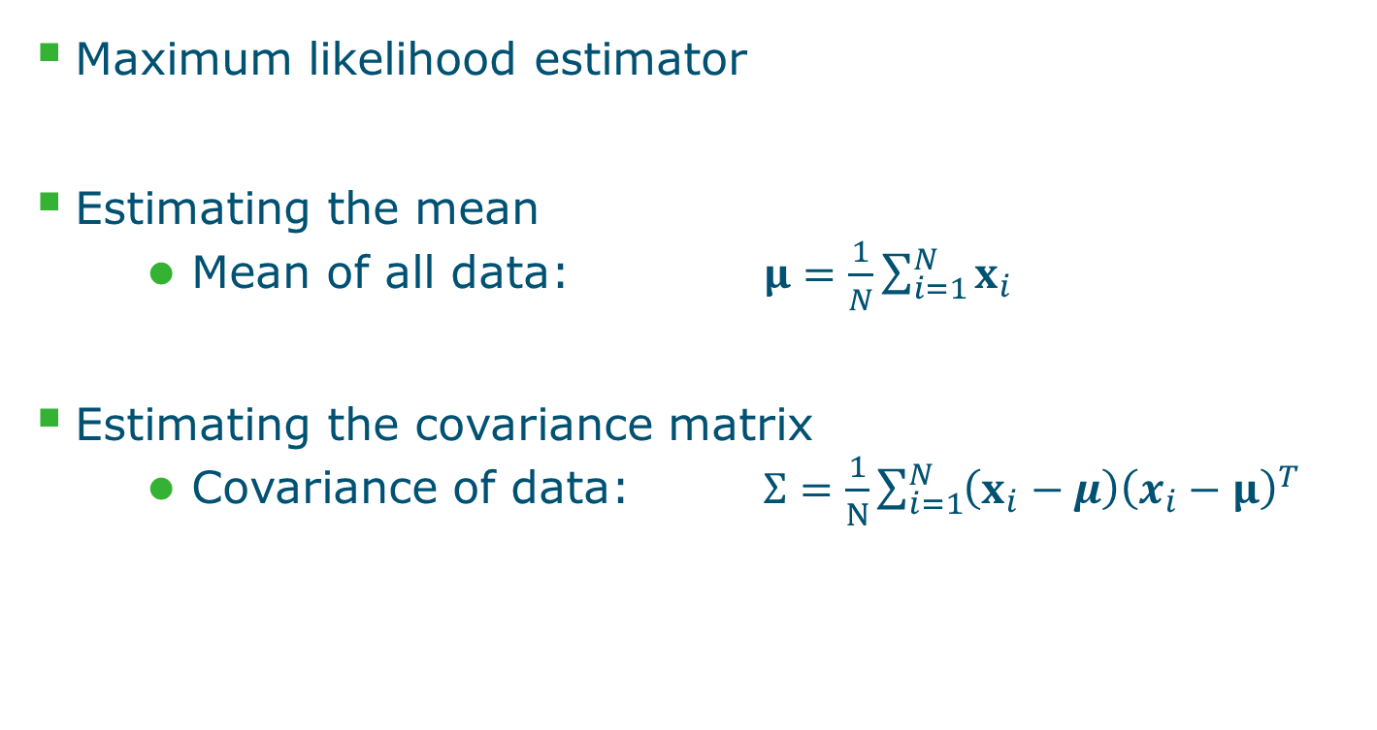
Fitting data to a Gaussian distribution
Maximum likelihood estimator
Estimating the mean
Mean of all data: $μ=\frac{1}{N}\sum_{i=1}^{N}{x_{i}}$
Estimating the covariance matrix
Covariance of data: $Σ=\frac{1}{N}\sum_{i=1}^{N}{\left(x_{i}−μ\right){\left(x_{i}−μ\right)}^{T}}$

Slide 13
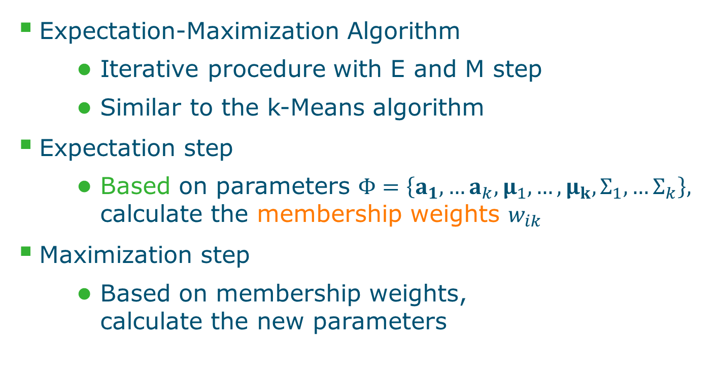
Fitting a GMM to the data:
Expectation-Maximization Algorithm
Iterative procedure with E and M step
Similar to the k-Means algorithm
Expectation step
Based on parameters $Φ=\left\{a_{1},…a_{k}, μ_{1},…,μ_{k}, Σ_{1},…Σ_{k}\right\},$ calculate the membership weights $w_{ik}$
Maximization step
Based on membership weights, calculate the new parameters

Slide 14
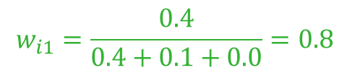
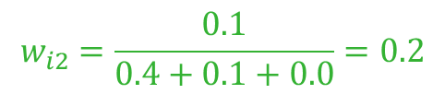

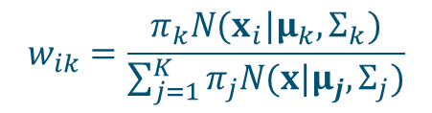
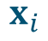
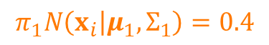
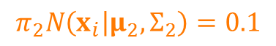
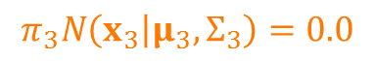
Expectation step
Determine the membership weights
$$w_{ik}=\frac{π_{k}N(x_{i}|μ_{k},Σ_{k})}{\sum_{j=1}^{K}{π_{j}N(x|μ_{j},Σ_{j})}}$$
$$π_{1}N\left(x_{i} | μ_{1},Σ_{1}\right)=0.4$$
$$π_{2}N\left(x_{i} | μ_{2},Σ_{2}\right)=0.1$$
$$π_{3}N\left(x_{3} | μ_{3},Σ_{3}\right)=0.0$$
$$w_{i1}=\frac{0.4}{0.4+0.1+0.0}=0.8$$
$$w_{i2}=\frac{0.1}{0.4+0.1+0.0}=0.2$$
$$w_{i3}=\frac{0.0}{0.4+0.1+0.0}=0.0$$
$$x_{i}$$

Slide 15
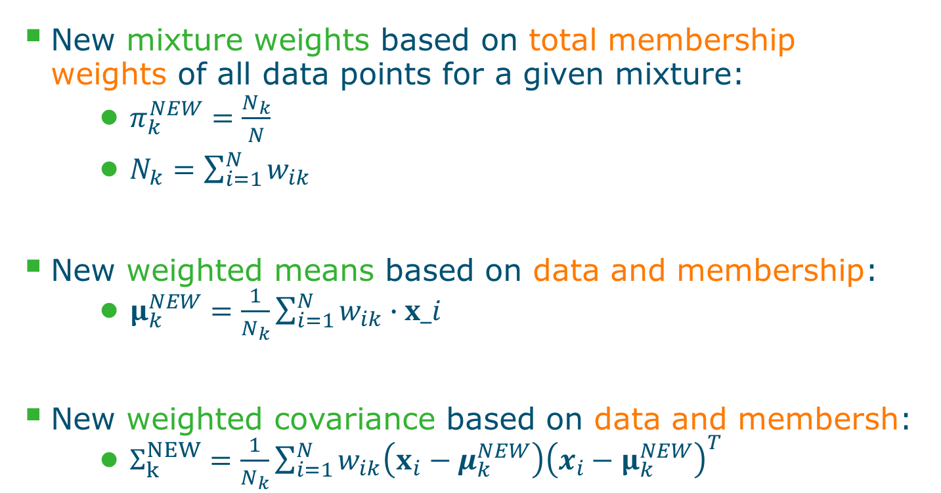
Maximization step
New mixture weights based on total membership weights of all data points for a given mixture:
$π_{k}^{NEW}=\frac{N_{k}}{N}$
$N_{k}=\sum_{i=1}^{N}{w_{ik}}$
New weighted means based on data and membership:
$μ_{k}^{NEW}=\frac{1}{N_{k}}\sum_{i=1}^{N}{w_{ik}∙x_i}$
New weighted covariance based on data and membersh:
$Σ_{k}^{NEW}=\frac{1}{N_{k}}\sum_{i=1}^{N}{w_{ik}\left(x_{i}−μ_{k}^{NEW}\right){\left(x_{i}−μ_{k}^{NEW}\right)}^{T}}$

Slide 16
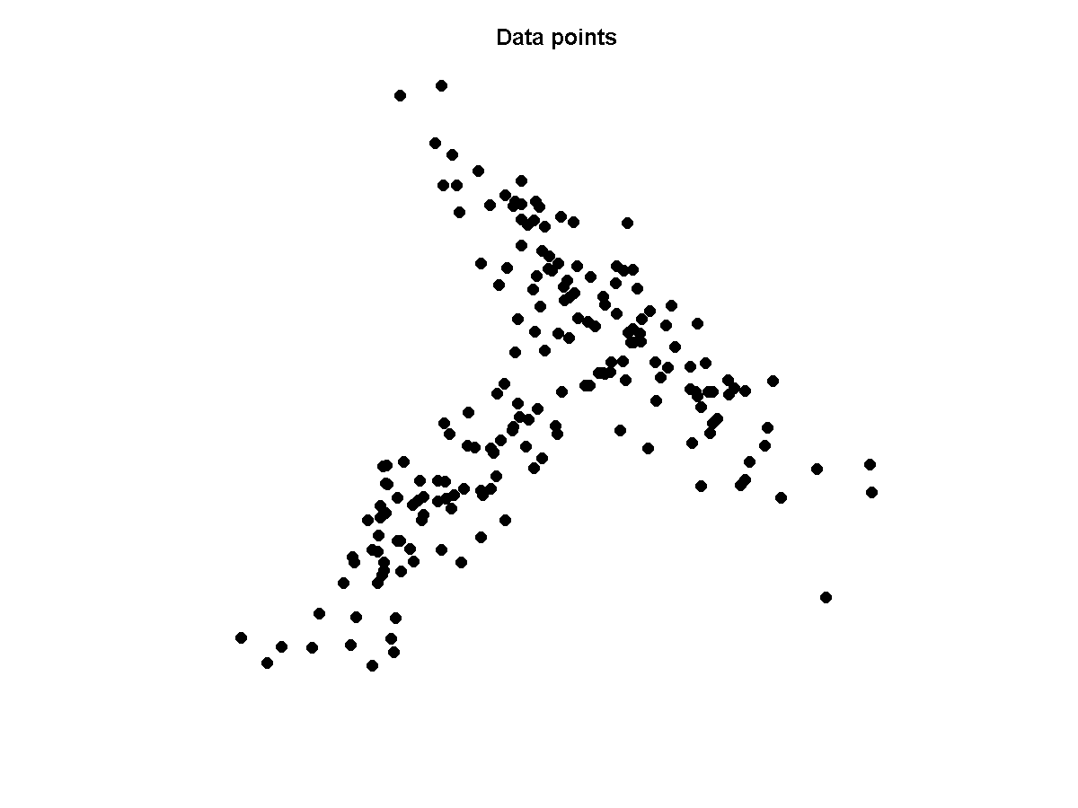
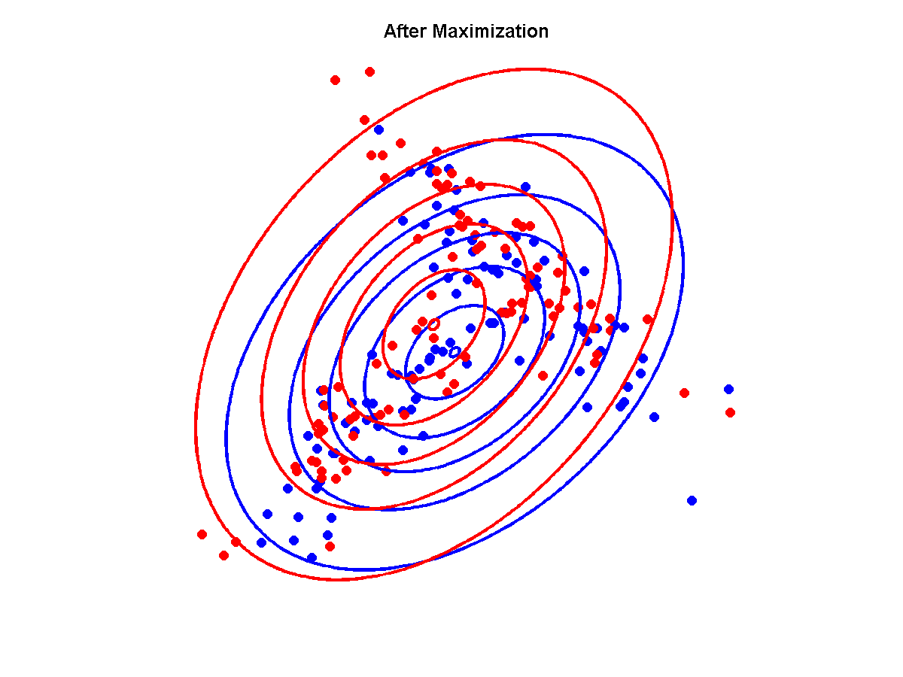
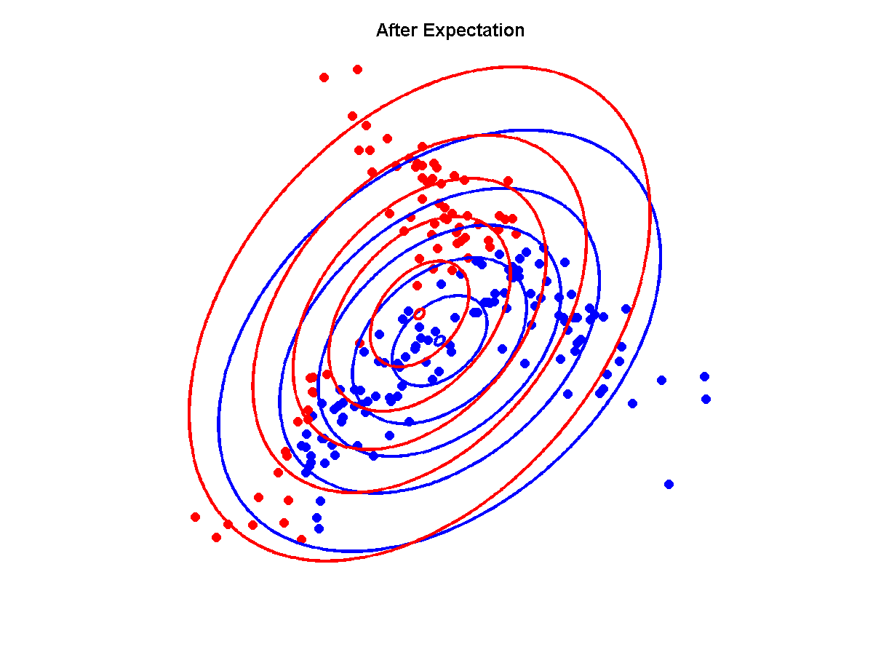


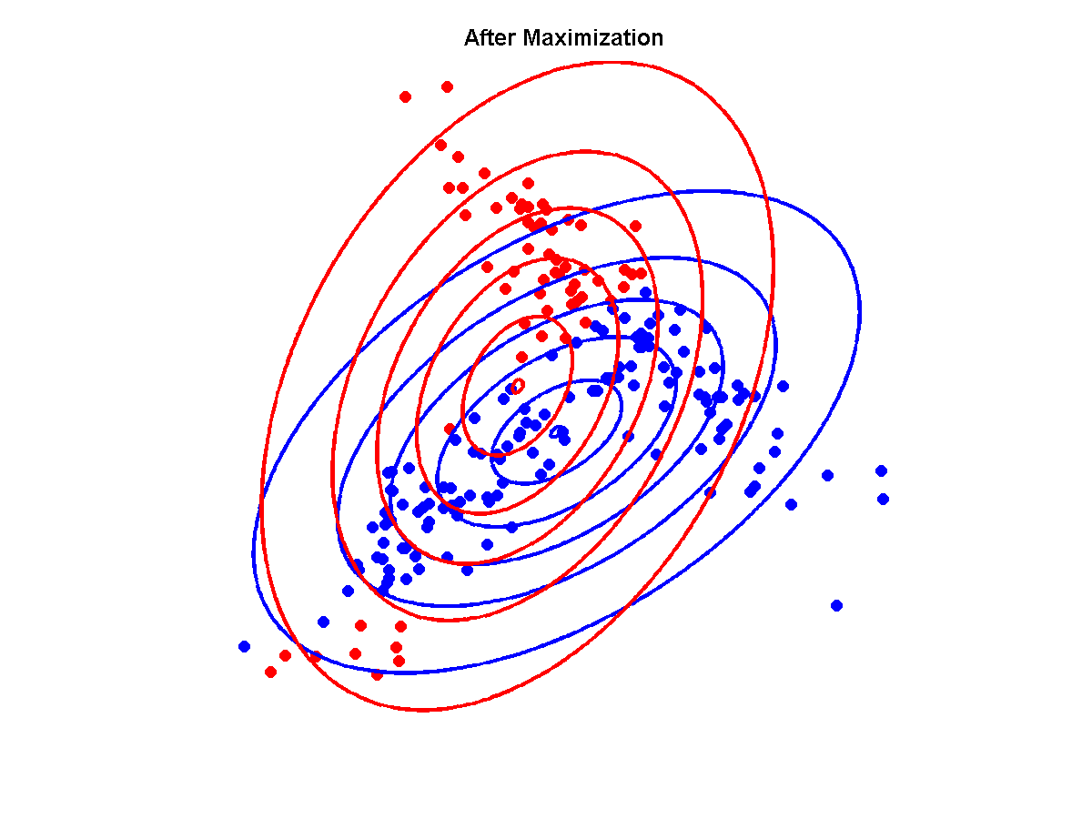

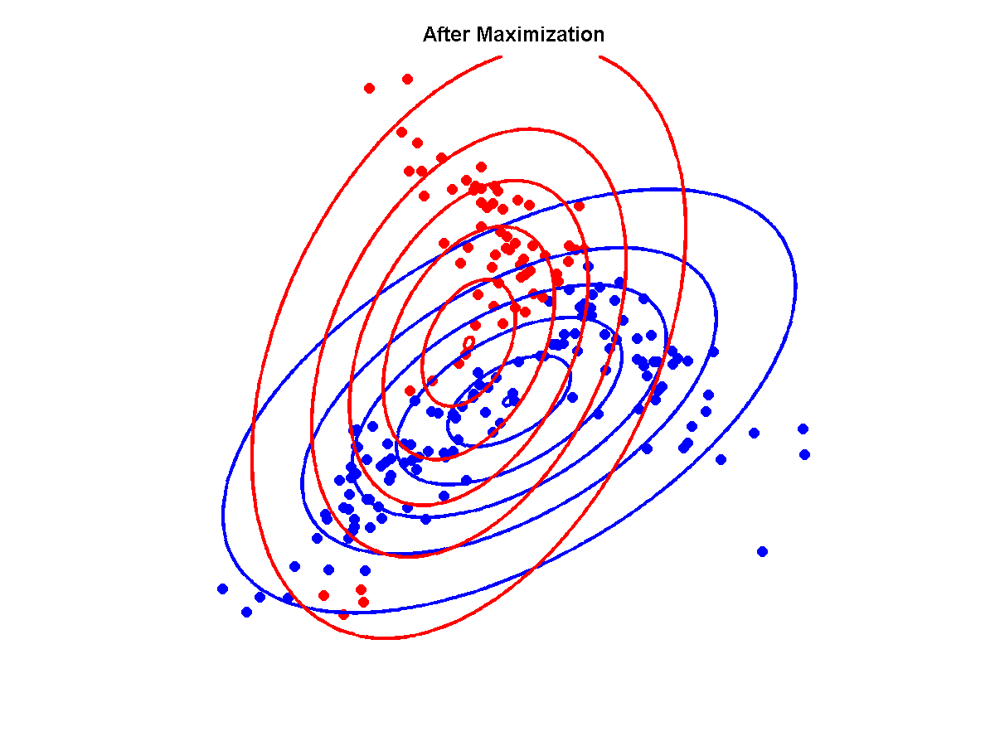








































Example of GMM with EM learning
Converged...

Slide 17

Quality of fit: log-likelihood
0
4
8
12
16
20

Slide 18



Some other mixtures

Slide 19






Image segmentation with k=3

Slide 20




Image segmentation with k=2

Slide 21



Choosing optimal k
BIC
Fit of the data
Penalty for complexity

Slide 22
Next Course
Entraînement
David Rousseau

